Slide 1
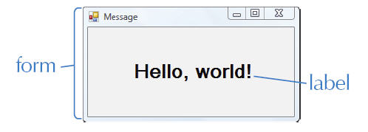
Chapter 2
Visual Basic Interface
Slide <number>
Notes:
A Visual Basic application contains a form and typically at least one label.
BASIC=Beginners All-Purpose Symbolic Instruction Code.
Windows apps have GUI. Contains a form, labels, buttons, textboxes and other control objects.

Slide 2
Chapter 2
Windows GUI
A GUI is a graphical user interface.
The interface is what appears on the screen when an application is running.
A GUI is event-driven, which means it executes code in response to an event.
An event can be an interaction from the user, such as a button click.
Slide <number>
Notes:
GUI stays on the screen until the Close button is clicked. This is an event and the application responds by closing itself.

Slide 3
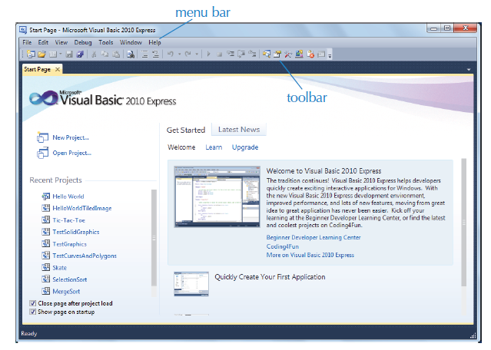
Chapter 2
The Visual Basic 2010 IDE
Slide <number>
Notes:
The Visual Basic 2010 Integrated Development Environment (IDE) contains a Start Page, menu bar, and toolbar.
Menu bar contains the names of drop-down menus that contain commands
The toolbar contain buttons that represent different action
The Start Page is a help window for getting started with application development. Click View\Start Page
A Web Browser can be opened within the IDE by selecting View\Other Windows\Web Browser

Slide 4
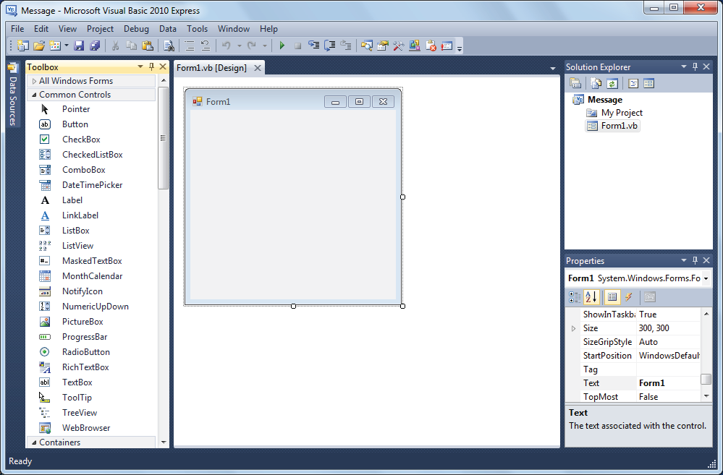
Chapter 2
The Design Window
Slide <number>
Notes:
An app consists of several related files. In VB they are collectively maintained as a project. Create a new Project by clicking button or File\New Project.
Select Windows Forms Application template. In the name box replace the existing text with a descriptive application name.
The Design window displays the application interface where objects are added, deleted, and sized.
The IDE also contains a Toolbox with controls that are grouped for easy access. Controls are used to create objects on the interface.
The Solution Explorer window in the IDE is used to switch between the Design and Code windows (the Code window is discussed later in the text).
The Properties Window (also discussed later in the text), lists the properties of a selected object on the application interface.
Overhead: prove it by going to a Project folder
When saving on Network drive: create folder structure: Projects\Ch_n\ Excercises Reviews Misc
Many unexplainable things are because of backward compatibility ( file names example )
IDE can be customized.

Slide 5
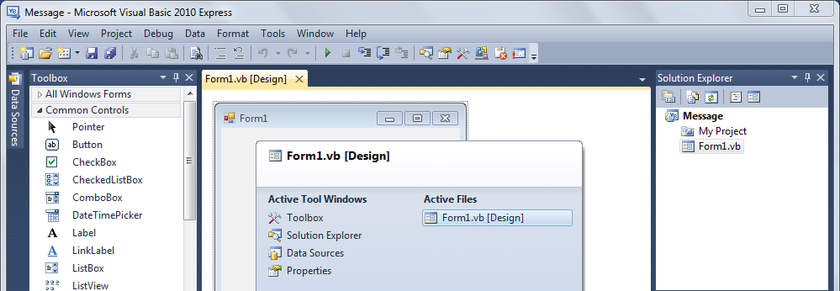
Chapter 2
The IDE Navigator
Slide <number>
Notes:
The IDE Navigator is used to switch between open files.
Not available through the menus, only short key: CTRL-TAB. Hold down the CTRL key and press TAB repeatedly until you select the file you intend to switch to.
To move through open files in order of use
To activate open documents in the order they were most recently touched, press CTRL + MINUS SIGN.
To activate open documents in the reverse order, press CTRL + SHIFT + MINUS SIGN.
Note Navigate Backward and Navigate Forward also can be found on the View menu.

Slide 6
Chapter 2
The Windows Form
A graphical object that contains a title bar, system menu, and Maximize, Minimize, and Close buttons.
To change the form size, click the form and then drag a handle.
A form has properties that define its appearance, behavior, position, and other attributes.
The Text property defines the text in the form's title bar.
Slide <number>
Notes:
Properties can be organized Alphabetically or Categorized.
A Property can be changed by typing or selecting a new value form list. Press Enter or click outside the Properties window to Save.

Slide 7
Chapter 2
The Label Control
(Name) should begin with lbl.
Text is the text displayed in the label. Cannot be changed by the user.
Font defines the font name, style, and size of the label text.
Autosize sizes the label to fit its text. Can be set to False so that the label size does not change.
TextAlign sets the alignment of the text within the label.
Slide <number>
Notes:
Toolbox=Control Class Objects
An object is related data and the instructions for performing actions on that data as described by other code called a Class. One Class can be used to create multiple objects. VB provides many built-in classes.
Controls are a type of Class for creating graphical objects that can be used in an application interface.
To add an object to a form click a Control in the Toolbox and then click the form.
Multiple Control Objects can be selected together using a technique called Marquee selection.

Slide 8
Chapter 2
Saving and running an Application
Save the application frequently to avoid losing changes
To Run and application Click the Start Debugging button or select Debug->Start Debugging
To Terminate a running application click on Stop Debugging button or select Debug->Stop Debugging
Running an application means that the program is first converted to a format the computer understands in a process called compiling
Slide <number>
Notes:
Write Hello, world!

Slide 9
Chapter 2
The MenuStrip Control
To add a menu to an interface, click the MenuStrip control and click the form.
A component that is displayed in the component tray at the bottom of the Design window.
Each menu name typed is a MenuItem with the properties:
  (Name) which is assigned automatically.
  Text is the menu or command name.
Slide <number>
Notes:
Typing a menu name displays automatically boxes for typing a command and another menu.
When a command or menu name is typed another box is automatically added to allow for more commands and menus.
A menu is modified in the Design window by clicking a MenuItem object and typing a new name.
Closing a Project is best done from File->Save all
Deleting a MenuItem is done by right clicking the item and selecting Delete.
To insert a new MenuItem above an existing one by right clicking and selecting Insert

Slide 10
Chapter 2
Program Code
A set of instructions called statements that tell the computer how to perform tasks.
OOP code is organized into classes, each defining a set of data and actions.
Program code for a Visual Basic application is typed into the Code window.
Form1 needs statements that instruct the computer how to respond to events.
Switch between the Design window and the Code window using the tabs or the Solution Explorer
Slide <number>

Slide 11
Chapter 2
The Event Procedure
A procedure is a block of code written to perform a specific task.
An event procedure, or event handler, performs a task in response to user interaction with an object.
A Click event procedure executes in response to a mouse click.
Event procedures are added to the Form1 class to add functionality to an application.
Slide <number>
Notes:
For example clicking a Menu command executes the Click event procedure for that MenuItem object. To add an event procedure to the Code window for that Menu option select the object name in the Class Name list and then select the event from the Method Name List. An empty event procedure is added. The procedure heading contains a set of parentheses with arguments. The arguments are values used by the procedure and will be discussed later. Do not modify them for now.
In an event procedure Private indicates that the procedure cannot be accessed from outside the Form1 class. Sub declares the procedure and End Sub ends it. Between them is the Body with statements to execute.
The Application.Exit() statement stops the program execution. Application is a VB class in the Forms class. The dot (.) followed by Exit means that the Exit() method of the Application should be executed. A method is named set of statements that perform a single well-defined task.
VB includes numerous built-in classes and methods for use in applications.
The ExitToolStripMenuItem Click event procedure is completed by adding the Application.Exit() statement.
The IDE automatically indents code for readabilty. One can use Tab key as well. Properly indenting code is GPS ( Good Programming Style ).
File->Print to print the Code.

Slide 12
Chapter 2
Using IntelliSense
It is a feature of VB that makes coding easier and less error-prone.
When a dot (.) is typed in a statement, a list of options is displayed.
The options displayed in the IntelliSense list are context dependent ( depend on what was typed before the dot)
Slide <number>
Notes:
For example typing a class name and then a dot displays a list with properties and methods of that class.
An IntelliSense list is displayed when an equal sign (=) is typed. The list contains possible values for assignment to the object on the left.

Slide 13
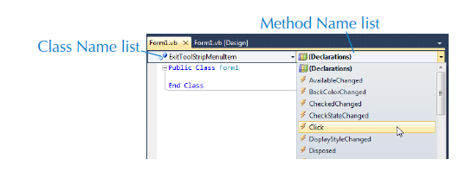
Chapter 2
The Code Window
Slide <number>

Slide 14
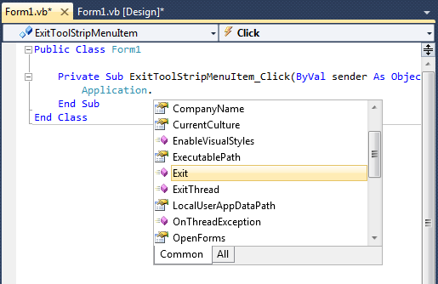
Chapter 2
Using IntelliSense
Slide <number>
Notes:
IntelliSense is the general term for a number of features: List Members, Parameter Info, Quick Info, and Complete Word. These features help you to learn more about the code you are using, keep track of the parameters you are typing, and add calls to properties and methods with only a few keystrokes.
The Visual Basic source code editor offers the following IntelliSense features:
- Syntax tips
- Syntax tips display the syntax of the statement that you are typing. This is useful for statements such as Declare.

Slide 15
Chapter 2
The Application Class
A built-in Visual Basic class.
Includes the Exit method. A method is a named set of statements that perform a specific task.
Methods of a class are accessed using the a dot (.).
The Application.Exit() statement stops program execution.
Slide <number>
Notes:
Add in Tuition Calculator Application.Exit()
PrintForm1.Print()
Application.Exit()
After printing document application ends.

Slide 16
Chapter 2
Assignment Statements
A statement that includes the equal sign (=) operator.
Assignment can be used to change a property value at run time. This type of statement takes the form:
    Me.Object.Property = Value
Me refers to the Form object, Object is the name of the control object, Property is the name of the property, and Value is the new property value.
Slide <number>
Notes:
A dot (.) is required between the Me ( the Form object ) and the Object (Name) to access the Form’s objects and again between the Object and the Property to access the object’s properties. The equal (=) sign is an operator that indicates the property on the left is to receive the value on the right at run time.
Example: Me.lblMessage.Text=“Smile!”
Assignements statements allow a single label to display different text at run time.

Slide 17
Chapter 2
The RadioButton Control
(Name) should begin with rad.
Text is the text next to the button.
Checked is set to True if the button should be displayed as selected. Only one radio button in a group can be selected at a time.
Note: radio buttons must be grouped in a GroupBox to work properly.
Slide <number>
Notes:
A group of radio buttons is often used in applications to enable the user to choose from a set of options.
A Click event procedure is usually coded for each RadioButton object.
Modify Hello World to Hello World international.
GroupBox is an object used to group related radio buttons.

Slide 18
Chapter 2
The GroupBox Control
(Name) should begin with grp.
Text is the text displayed at the top of the group box.
Slide <number>
Notes:
A GroupBox must be added to added to the Form before adding RadioButton objects.
There are typically no event procedures associated with a group box.

Slide 19
Chapter 2
Comments
Used to explain and clarify code for other programmers.
Have no effect on the way an application runs.
Begin with a single quotation mark (').
Inline comments are comments placed on the same line as a statement. These should be used where additional explanation may be needed.
Multiline comments, sometimes called comment blocks, appear at the beginning of a program line.
Slide <number>
Notes:
GPS to add at beginning a block of comments with:
‘Name of program
‘Date
‘What the application does

Slide 20
Chapter 2
Arithmetic Operators and
Numeric Expressions
Arithmetic operators are used to form numeric expressions.
Built-in arithmetic operators include:
  ^ (exponentiation)
  * (multiplication)
  / (division)
  + (addition)
  – (subtraction).
Slide <number>
Notes:
A numeric expression can be used anywhere a number is allowed.
It is good programming style to use parentheses when there is any ambiguity or question about the numeric expression so a programmer reading the code will not have any doubts about what is intended.
Example: Me.lblAnswer.Text = 2+6*3

Slide 21
Chapter 2
Operator Precedence
Operators in Visual Basic have the following precedence:
1. exponentiation
2. multiplication and division
3. addition and subtraction
Operators of the same precedence are evaluated in order from left to right. For example, multiplication is performed first, then division, and finally addition:
5 + 6 * 4 / 2 = 17
Slide <number>
Notes:
PEMDAS = Parentheses, Exponents, Multiplication, Division, Addition, Subtraction

Slide 22
Chapter 2
Changing the Order of Operations
The order in which operators are evaluated can be changed by using parentheses. For example, addition is performed first, then multiplication, and finally division:
(5 + 6) * 4 / 2 = 22
Slide <number>

Slide 23
Chapter 2
The Button Control
(Name) should begin with btn.
Text is the text displayed on the button.
A Click event procedure is usually coded for a Button object and executes when user clicks the button
Slide <number>
Notes:
A Click event procedure is usually associated with a button object.

Slide 24
Chapter 2
Finding Help
Two type of Help: local and online.
Help->Manage Help settings. Choose Online or local
Online is the better option.
Visual Basic displays context-sensitive help related to the keyword or task you are working on. Select the keyword and press F1.
Slide <number>
Notes:
A Click event procedure is usually associated with a button object.

Slide 25
Chapter 2
Code Conventions
Control objects should be given a descriptive name that begins with an appropriate prefix.
Begin object property assignment statements with Me.
Use comments to include information such as the programmer's name and the date.
Comments should be used wherever code may be ambiguous, but not reiterate what is clear from the code.
Statements in a procedure should be indented.
Slide <number>
Notes:
Code conventions are a set of guidelines for writing an application. Code conventions can make modifying and maintaining code faster, easier, and less expensive.

Slide 26
Chapter 2
Create Project
Create a Windows application by creating a new project that uses the Windows Application template. Templates allow for quicker application development and are the basis of the RAD (Rapid Application Development) approach implemented by Visual Basic.
Object is a term that should be emphasized. An application interface is a Form object generated from the Form control class and it typically contains other control class objects. Control class objects have properties that can be set and events that can be coded.
Slide <number>

Slide 27
Chapter 2
Create Project
A number of files and folders are automatically generated when a Visual Basic project is created. For every Visual Basic project, there is a project workspace file (.vbproj), a solution file (.sln), a bin folder, an obj folder, a My Project folder, several .vb files, and an assembly resource file (.resx). If a Visual Basic application is to be modified on a different computer, the folder with the name specified in the New Project dialog box when the project was created and all its contents must be copied to the other computer.
Slide <number>

Slide 28
Chapter 2
Create Project
The Visual Basic IDE can be customized to allow for bigger Design and Code windows. The Solution Explorer, Properties, Toolbox, and Debug windows are Tool windows. They can be sized by dragging the bottom border, closed by clicking the Close button, hidden by clicking the AutoHide button, and viewed by selecting the window name from the View menu. View j Toolbars can be selected to hide or display available toolbars.
Properties window can display object properties in alphabetical order instead of by category.
Slide <number>
Notes:
Students may find it easier to locate a property when the Properties window displays object properties in alphabetical order instead of by category. Clicking the Alphabetic button in the Properties window lists the property names in alphabetic order. Clicking the Categorized button lists the property names by category. (Refer to page 37 in the text for more information about this topic.)

Slide 29
Chapter 2
Create Project
A Form object, like any object, can be sized by dragging a handle. A form should be sized to accommodate objects. The form should be large enough to space objects, but not unnecessarily large.
The Label Control
The Font property contains subproperties that are displayed by clicking the + beside Font in the Properties window. Subproperties include Name, Size, Bold, and Italic.
Double-clicking an object on a form displays the Code window and creates an event procedure. If this occurs accidentally, students should delete the procedure and then close the Code window to return to the Design window.
Slide <number>
Notes:
Students sometimes mistake the (Name) property for the Text property. If a form name has been changed, the form’s title bar will not change. However, the Code window will display Public Class FormName rather than Public Class Form1. The file name of the form in the Solution Explorer window will remain Form1.
If you would like your students to descriptively name the application form, the (Name) property should be used. Refer to the previous paragraph for more information. To change the name of the form file, right-click the name in the Solution Explorer window and then select Rename from the displayed menu.

Slide 30
Chapter 2
Create Project
Saving and Running an Application
- File SAVE ALL and then select an appropriate Name for this project, Hello World.
Select MyDocuments and then make sure you create a new Folder for this project.
During compilation, high-level programming languages such as Visual Basic are translated into assembly language with a program called a compiler. An assembler then translates the program into its final form, machine language. Machine language is comprised of just 1s and 0s and is the only language that a computer understands.
Slide <number>
Notes:
There is no option for saving a project under a different name. Once saved, an application cannot be saved under a different name. However, a new project of the desired name can be created and then the Project j Add Existing Item command used to copy in the Form1.vb file from the other application.

